Slide 1
Digital Communication
Dr. M. Venu Gopala Rao
A.M.I.E.T.E, M.Tech, Ph.D(Engg)
Cert. in R.S.T ( City & Guild’s London Institute, London)
F.I.E.T.E, L.M.I.S.T.E, I.S.O.I., S.S.I., M.I.A.E.
Professor, Dept. of ECE, K L University
mvgr03@kluniversity.in

Slide 2
Characteristics of Communication Channels

Slide 3
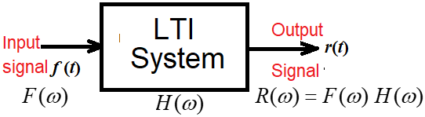
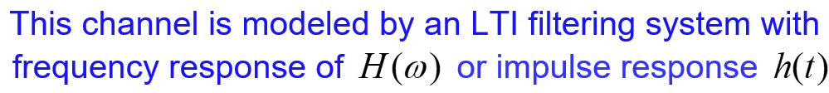
Distortion-less Transmission (Ideal channel characteristics)
The distortion-less transmission should have the following characteristics shown below:.

Slide 4


Distortion-less Transmission (Ideal channel characteristics)

Slide 5

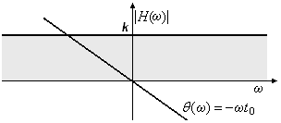

Frequency Response of Distortion-less Transmission (Ideal channel characteristics)

Slide 6
The transmission of digital data over a baseband channel
Digital data have a broad spectrum with a significantly low-frequency content.
Base-band transmission of digital data therefore requires the use of a low-pass channel with a band width large enough to accommodate the essential frequency content of the data stream.
Dispersive nature of channel:
Typically, however, the channel is dispersive in that its frequency response deviates from that of an ideal low-pass filter. The simplest example of a dispersive channel is the band-limited channel.
The result of data transmission over such a channel is that each received pulse is affected somewhat by adjacent pulses causing bit errors, thereby giving rise to a common form of interference called inter symbol interference (ISI).
Pulse shaping criteria is used in both transmitter and receiver to eliminate the ISI.

Slide 7
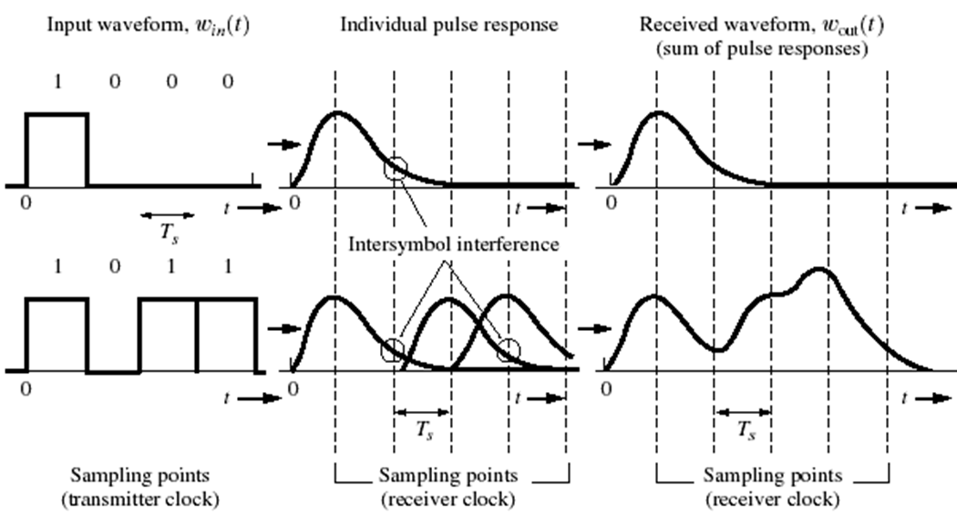
Dispersive channel causes Inter Symbol Interference

Slide 8
The transmission of digital data over a baseband channel
Channel Noise:
Another source of bit errors in a baseband data transmission system is the ubiquitous receiver noise (channel noise).
Channel noise is independent of the transmitted signal; its effect on data transmission over the band-limited channel shows up at the receiver input, once the data transmission system is switched on.
A basic problem that often arises in the study of communication systems is that of detecting a pulse transmitted over a channel that is corrupted by channel noise.
A device (an LTI filter) for optimum detection of a pulse corrupted by noise in the channel is referred to as Matched filter

Slide 9
The transmission of digital data over a baseband channel
Other impairments include:
Attenuation,
Non-linear distortion: Arises from non-linearities in amplifiers and companders. Effect is small but difficult to correct.
Frequency off-set: Approximately less than 5 Hz. Effect is severe in high-speed transmission systems and synchronous coherent detection.
Phase delay and phase jitter: Low index frequency modulation with the low-frequency harmonics of the power line (50 Hz).
Impulse and thermal noise.

Slide 10
End

